Slide 1




Predicting Crime and Proposing
Safer Neighborhoods: Using Machine Learning Models

Slide 2


Agenda
2
Abstract
Chapter 1- Introduction
Chapter 2- Data Management Plan
Chapter 3- Data Engineering
Chapter 4- Modelling
Summary

Slide 3







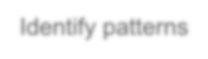




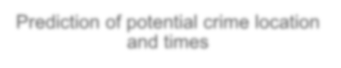




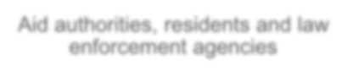
Abstract
3
Large amount of data
Leverage past crime data and by utilizing machine learning and data-driven methods, detect areas with an increased likelihood of criminal activity in advance.
Identify patterns
Raise public awareness about high-risk areas, and enable authorities to anticipate criminal activities for better allocation of police resources.
Prediction of potential crime location
and times
Predictive policing aims to enhance public safety through preemptive actions and specific interventions, aiming to prevent incidents from happening.
Aid authorities, residents and law enforcement agencies

Slide 4
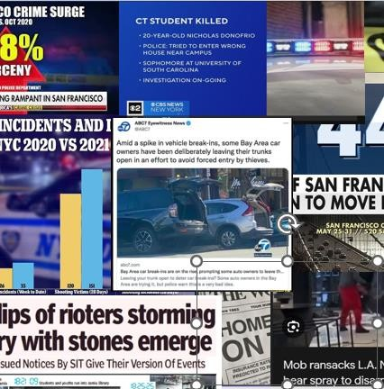
Introduction
4
Crime has a significant impact on individuals, families, and societies by causing economic setbacks and social disturbances.
Factors such as socioeconomic inequalities, limited opportunities, substance abuse, and firearm availability contribute to crime in urban areas.
Poverty and unemployment drive illegal activities while societal inequities compound challenges in marginalized neighborhoods.

Slide 5







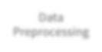


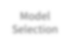


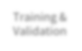






Objective & Approach
Data
Collection
Data Preprocessing
Crime Prevention Through Proactive Measures.
Resource Allocation Optimization.
Model
Selection
Public Safety and Awareness.
Training & Validation
Reduced Social and Economic Impact.
Making Communities Safer.
Evaluation
Final Model

Slide 6
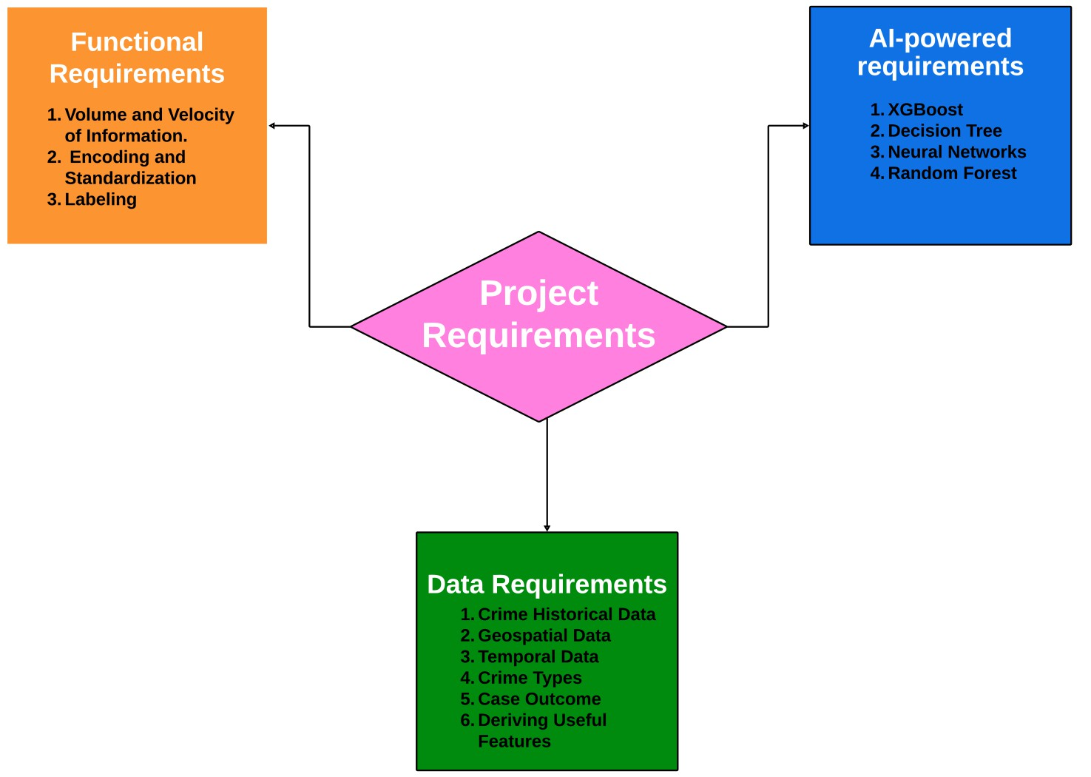
Project Requirements
6

Slide 7
Technology, Literature and Solution Survey
7
Lin et al. (2017) proposed a data-driven approach using machine learning to combat drug-related crime in Taiwan, achieving an 87% accuracy. The strategy emphasizes addressing low-level crimes and utilizes the R programming language and the H2O package.
Walczak et al. (2021) utilized neural networks to forecast crime using a dataset from Detroit, achieving 16.4% accuracy for 38 crime categories and an improved accuracy of 27.1% when categorized into seven groups.
Divya et al. (2022) proposed an innovative approach to increase security measures using deep learning and achieved an accuracy pf 79%.
V. Balu et al. (2022) focuses on predicting the likelihood of various crime types as their primary objective.
Kumar et al. (2020) utilized The K-nearest neighbor algorithm to forecast the most common crime in a
particular area, yielding a 99% precision when 'k' is configured to 3.
Ahishakiye et al. (2017) predicted crime categories using the decision tree algorithm based on Violent Crimes Per Population, achieving an exceptional accuracy rate of 94.3%.

Slide 8
Technology, Literature and Solution Survey
8
Bharati et al. (2018) utilized machine learning algorithms to predict crime in Chicago. Achieved high
accuracy with decision trees and random forest models.
Shah et al. (2021) Explored the integration of Machine Learning and computer vision in crime prediction, emphasizing ongoing area surveillance for enhanced crime prevention.
Krishnaveni K.P. et al. (2022) Explored different machine learning and deep learning methods for predicting crimes, highlighting the significance of using a variety of data sources and recognizing the difficulties in interpreting models.
Dr. B.S. Jadhav et al. (2021) performed thorough analysis of machine learning methods for predicting criminal behavior, discussing challenges and exploring alternative approaches such as Natural Language Processing and Computer Vision.
J. Arunnehru et al. (2021) developed a system that combines convolutional neural networks and support vector machines for real-time crime intention detection, achieving an accuracy of 95% on a dataset comprising 10,000 video clips.
Grega et al. (2013) created a customized 3D CNN model to detect criminal intentions in cases of shoplifting, achieving a notable accuracy rate of 75% and demonstrating superiority over current systems.

Slide 9
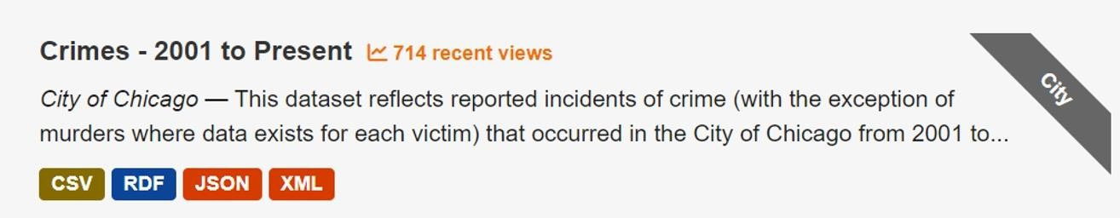

Data Management Plan
9
We chose Chicago crime dataset – 2001 to present which is of 1.86GB
For storage we have utilized google drive, emphasized the efficient management of data, such as data
manipulation, normalization due to its accessibility and collaborative capabilities.
Scheduled to delete Google Drive files by January 01, 2024, yet will keep datasets on Kaggle for accessibility, collaboration, and visibility purposes while ensuring data integrity and openness.

Slide 10
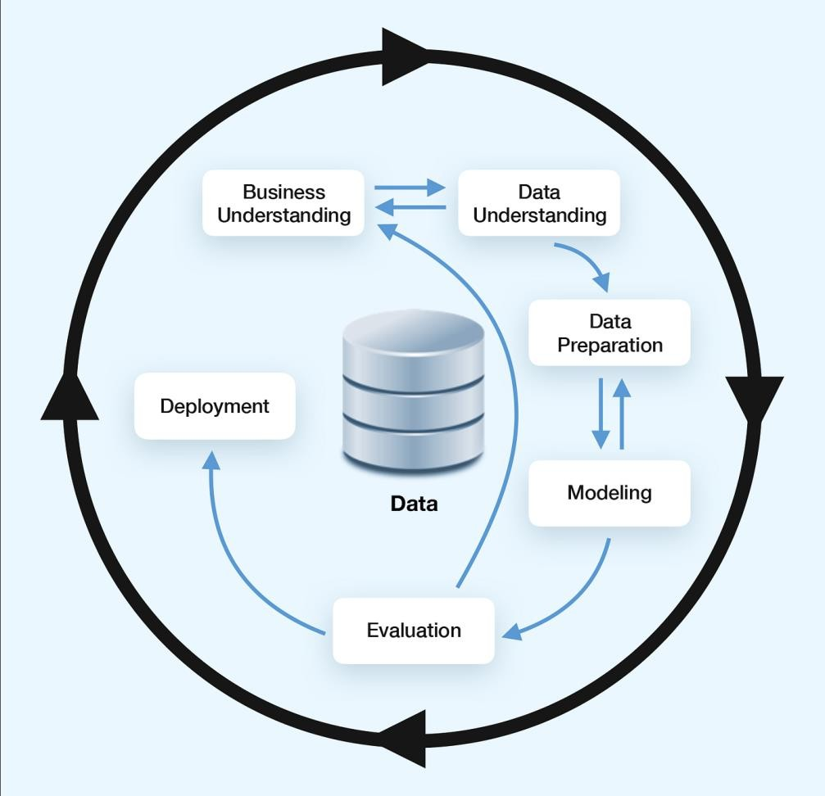
Data Management Plan
10
Business understanding – Project background, objective, plan
Data understanding – Determine the data required for the targeted problem
Data preparation – Ensure the data well-
organized for modeling
Modeling – Multiple models training, validation and testing
Evaluation – Performance evaluation by various metrics
Deployment – Make our work publicly accessible

Slide 11
Hardware and Software Requirements :
Hardware & Software | Configuration | Duration | Purpose | Cost
Data Storage | Google drive | 2 Months | For storing the CSV files | Free
Local Machine | 64-bit version | 2 Months | For Computations | $900
CPU | Intel Core i7 or AMD Ryzen 7 | 2 Months | For executing instructions and processing data | $300
GPU | Nvidia GeForce RTX 3060 or AMD Radeon RX 6600 | 2 months | machine learning computations | $150
Python | Version 3.12.0 | 2 Months | Programming language for machine learning | Free
NumPy | Version 1.23.3 | 2 Months | Model Deployment | Free
Pandas | Version 1.5.2 | 2 Months | Data analysis and manipulation | Free
Scikit-learn | Version 1.1.3 | 2 Months | Machine learning algorithms | Free
MySQL(Community Edition) | Version 8.0.33 | 2 Months | Production database | Free
Tableau Desktop | 2023.3 | 2 Months | Data visualization | Student License
Python Jupyter Notebook | Version 7.3.1 | 2 Months | Data exploration, Data Pre-processing (Writing python script) | Free

Slide 12
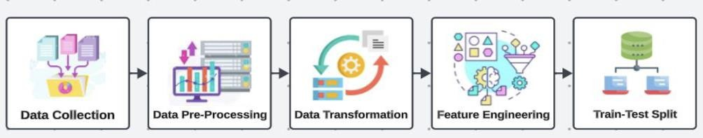

Data Engineering
18
Data Collection
Utilize various sources like government databases, law enforcement agencies, and openly available datasets.
Obtain the dataset from the government website due to its comprehensibility and reliability.
Data Pre-processing
Clean the data by removing duplicates, handling missing values.
Data Transformation
Encode categorical variables and scale numerical features for consistency and accuracy.
Use Lasso Regression (L1 Regularization) and domain knowledge for feature extraction.
Data Preparation
Split the dataset into training (70%), validation (20%), and test (10%) sets.
Data Statistics
Summarize and display the results of the previous stage in visualization formats.

Slide 13
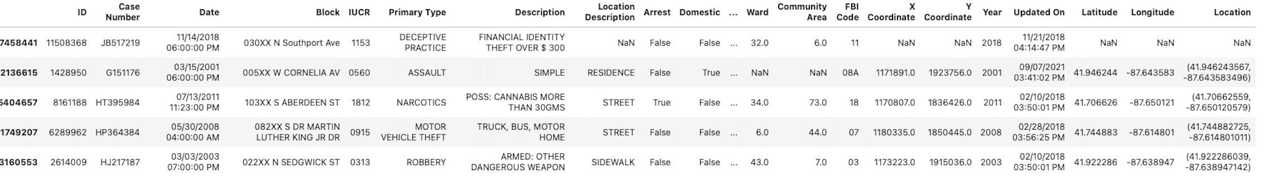
Data Collection-Sample Data Collected From data.gov
19

Slide 14
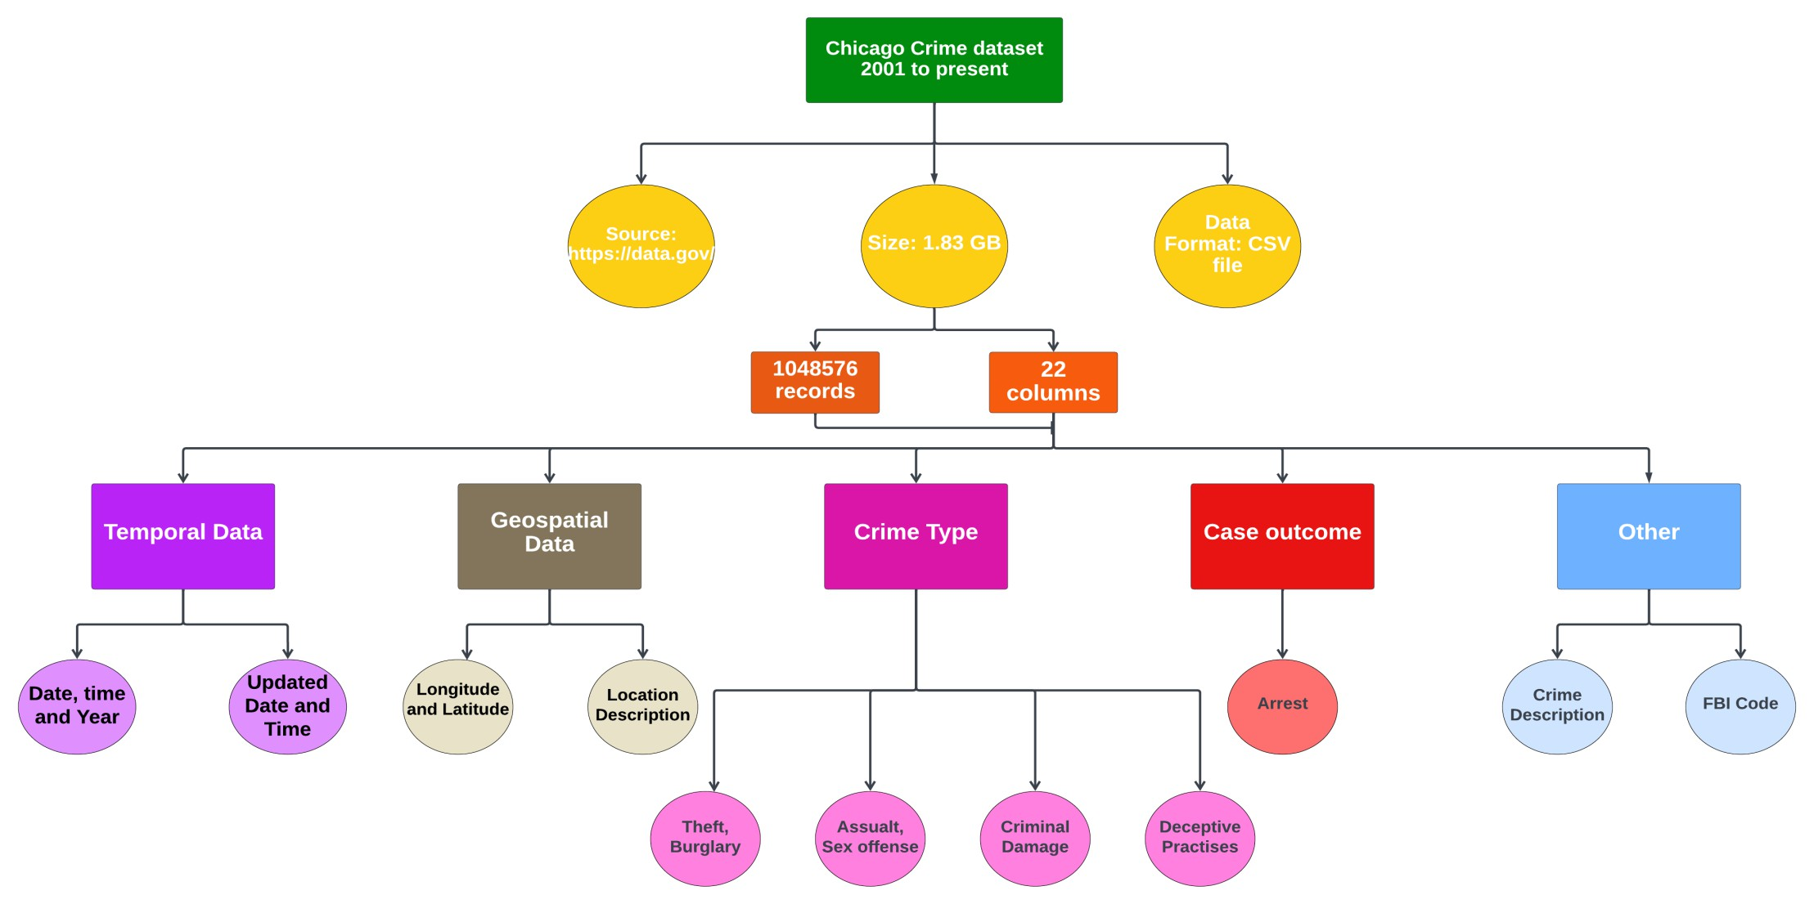
Dataset description
20

Slide 15
Data Collection-Sample Data Collected From data.gov
21

Slide 16
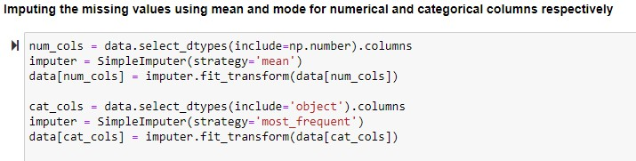
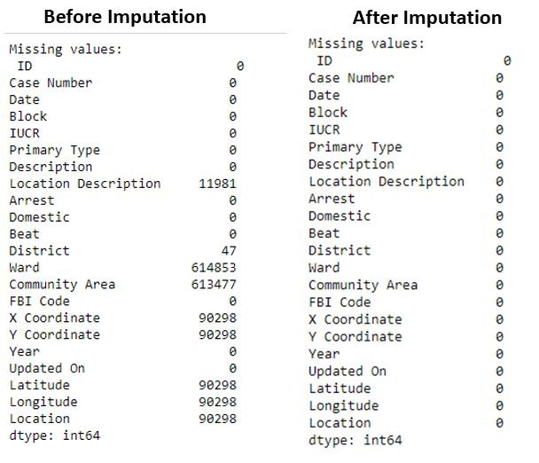
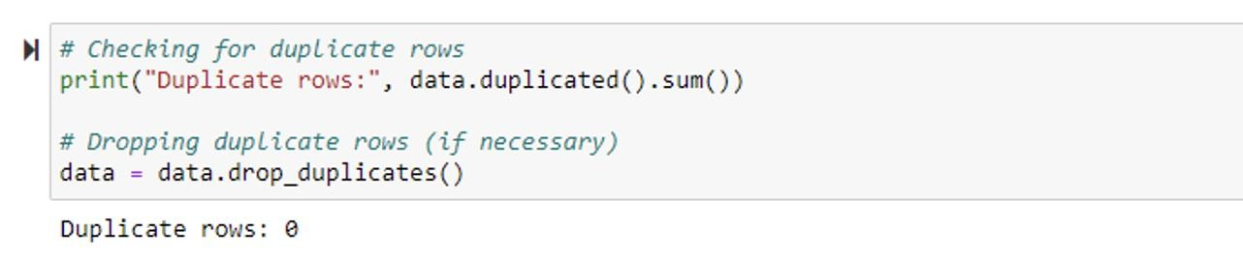

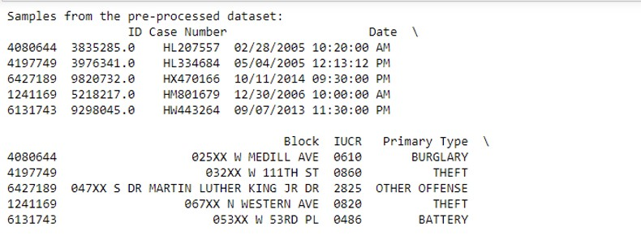
Data Pre-processing
22

Slide 17
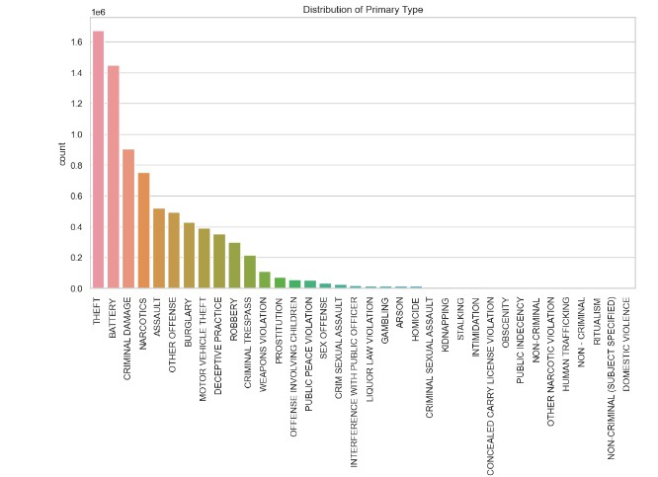
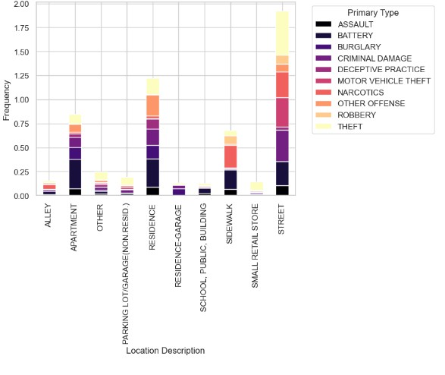
Exploratory Data Analysis
23

Slide 18
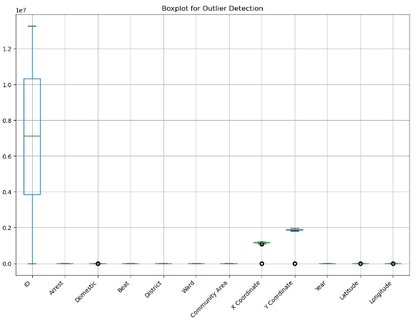
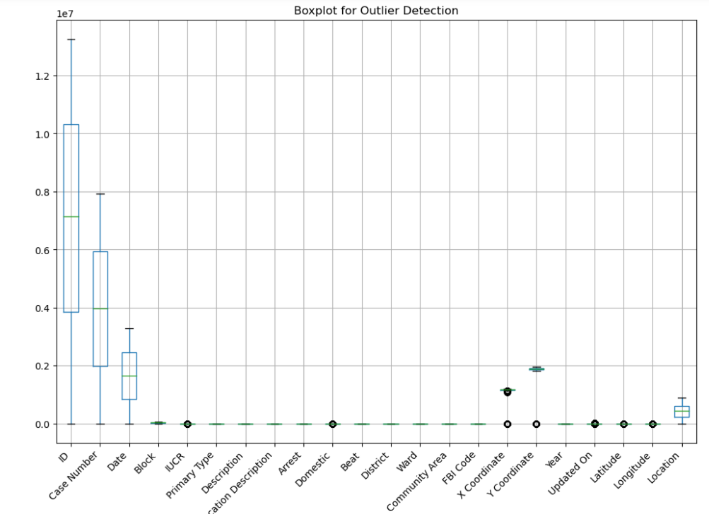
Outlier detection analysis
24
Outlier analysis before encoding
Outlier analysis after encoding

Slide 19
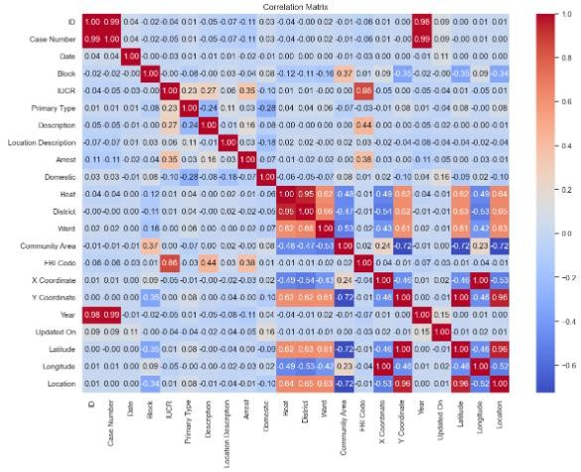
Correlation analysis
25
Correlation analysis provides a basis for understanding potential relationships between the target variable 'Primary Type' and other variables.
Guides the development of features and models for predicting crime types.

Slide 20
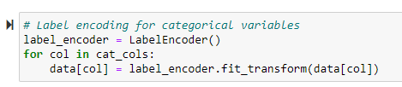
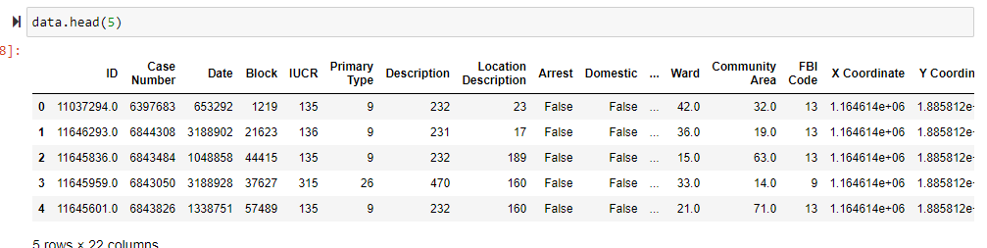
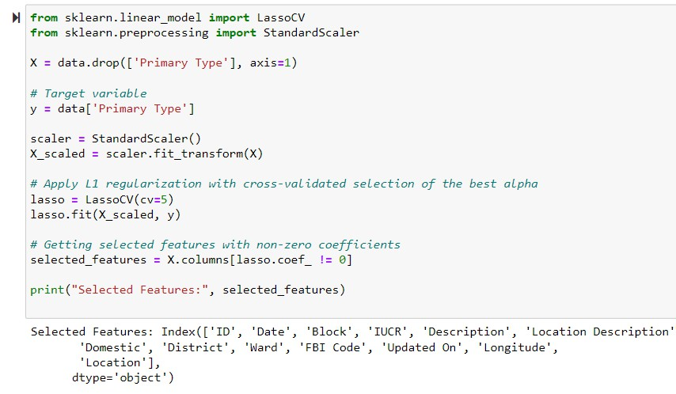
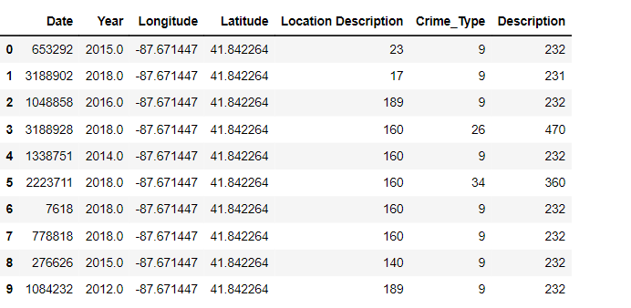
Data Transformation
26
Label encoding is used to transform categorical values into numerical values.
Lasso Regression is used for feature selection.
‘Primary Type’ is renamed to ‘Crime_Type’.

Slide 21
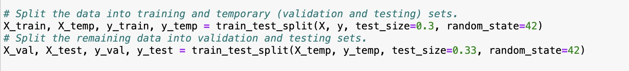
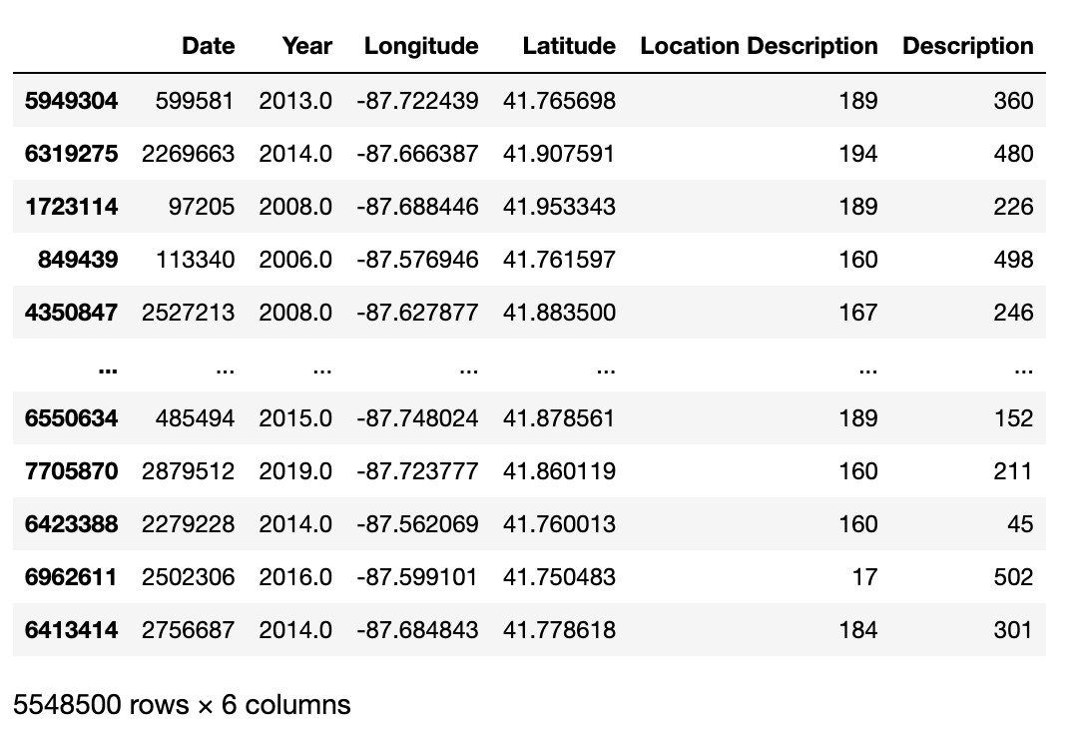
Data Preparation
27
Sample of training data
Training dataset is used to capture underlying patterns.
The validation dataset is for hyperparameter tuning purpose.
The testing dataset is employed to evaluate the performance

Slide 22
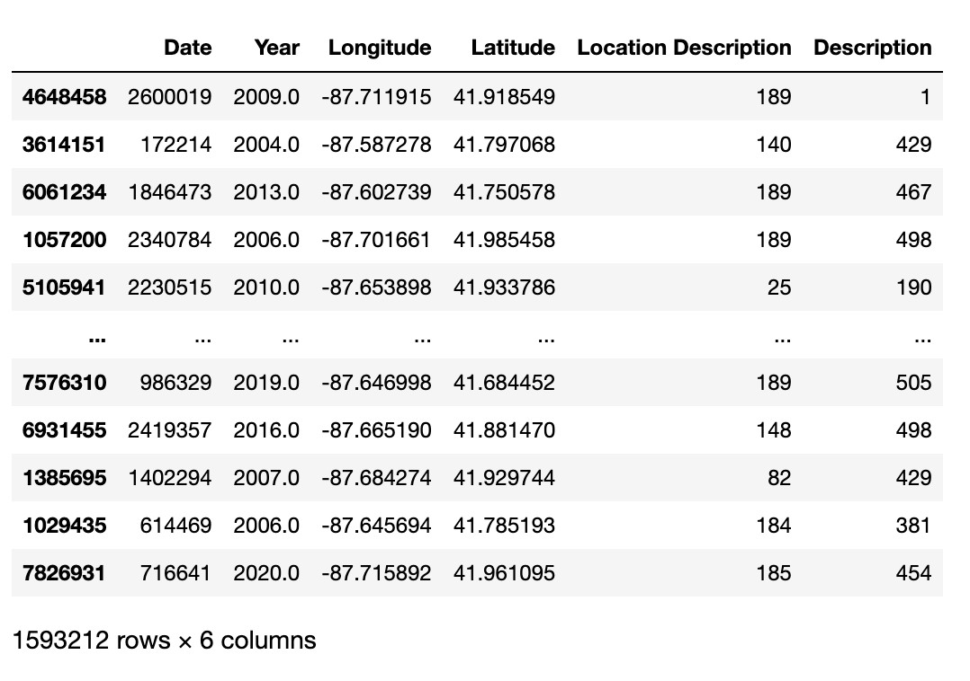
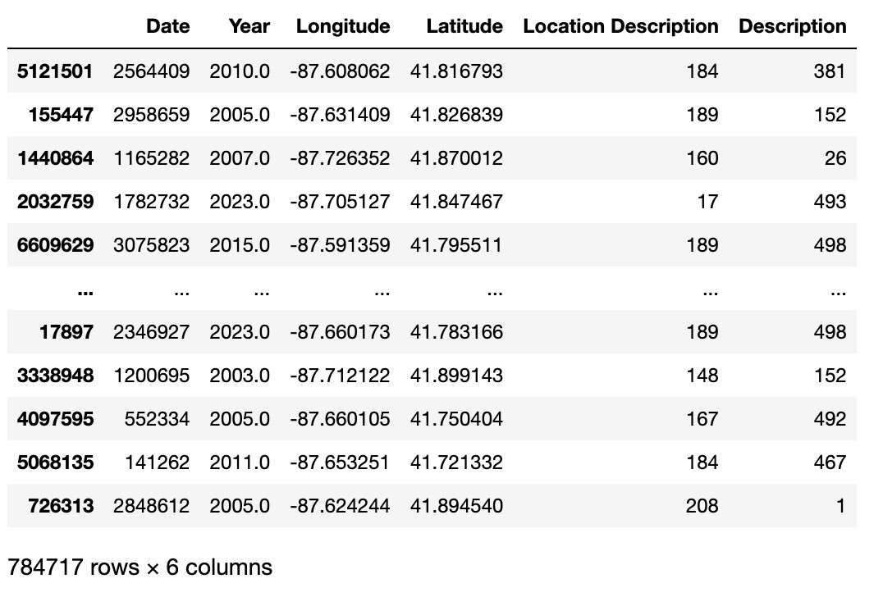
Data Preparation
28
Sample From the Validation Dataset
Sample From the Testing Dataset

Slide 23
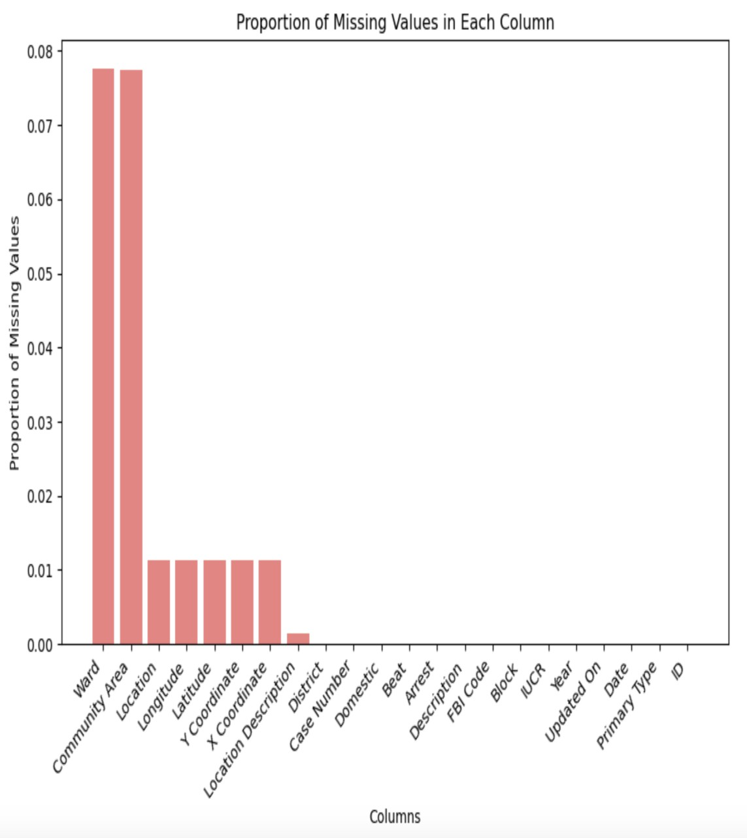
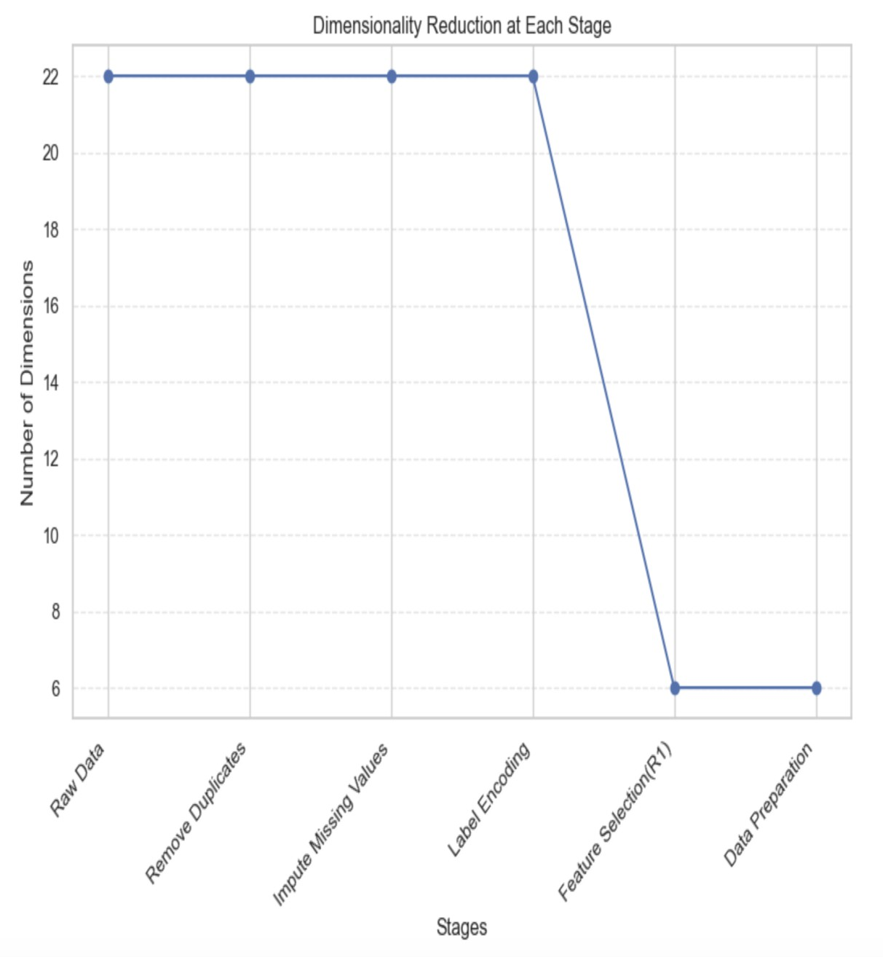
Data Statistics
29

Slide 24
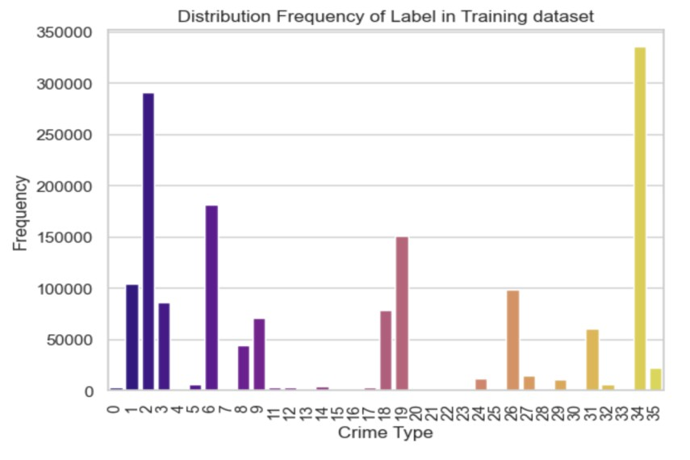
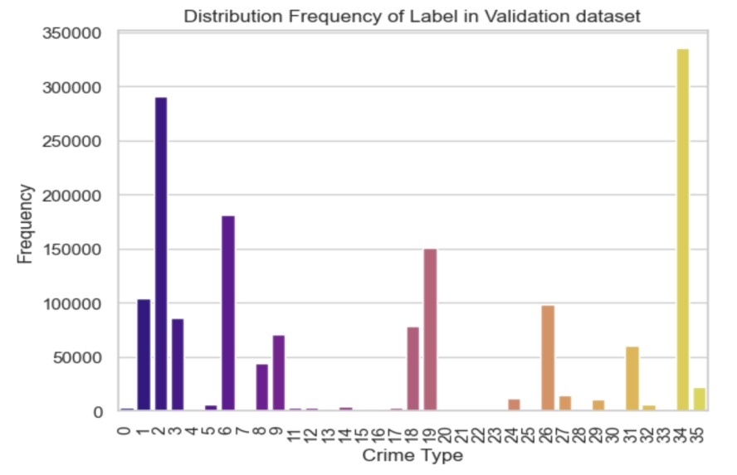
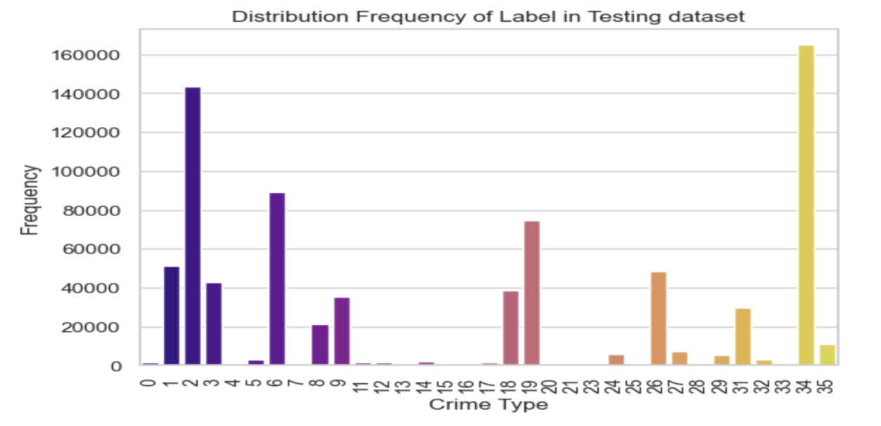
Data Statistics
30

Slide 25
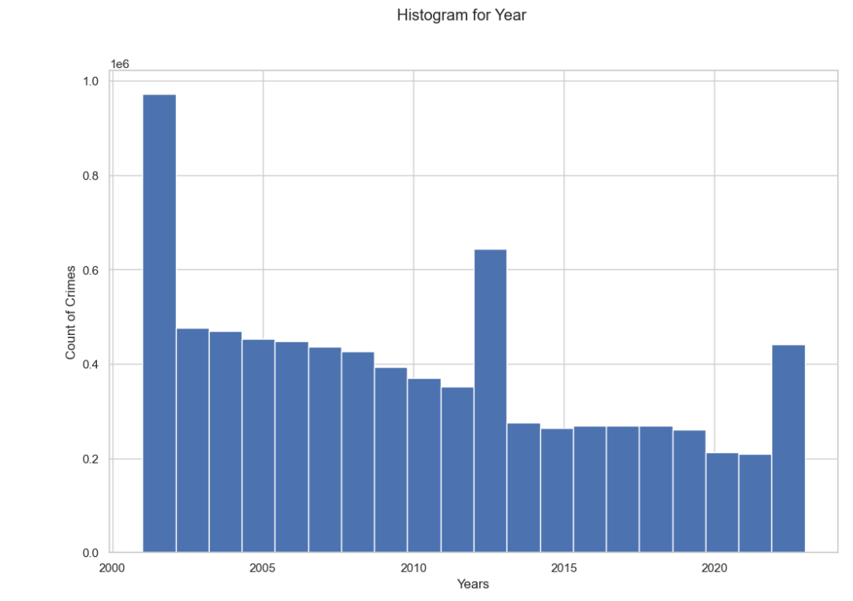
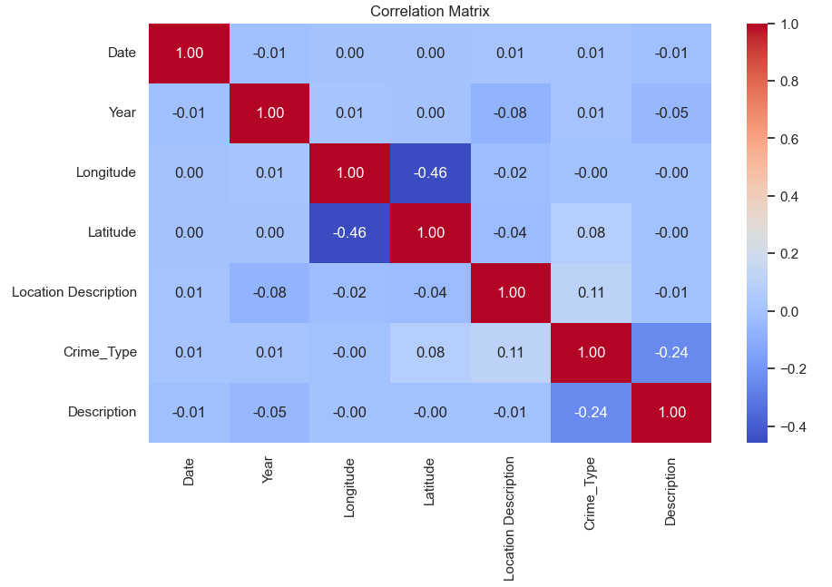
Data Analytics
31

Slide 26
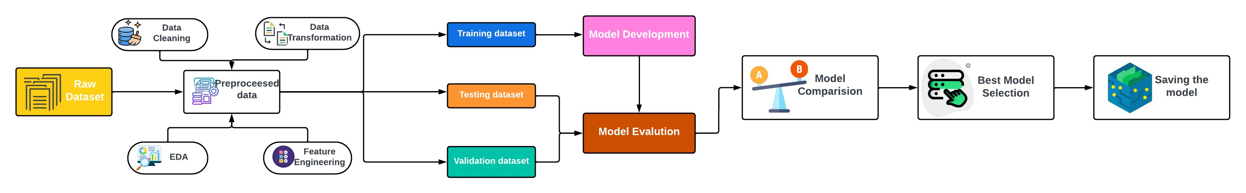
Project Architecture
32
Started with a raw dataset and preprocessed it using multiple techniques.
Divided the preprocessed dataset into 3 parts : 70% into Training, 20% into Validation and 10% into
Testing.
Developed Machine Learning models on Training dataset.
Evaluated the performance of the models using Validation and Testing datasets.
Compared models based on evaluation metrics to find the best performing model.
Saved the Baseline and Hyper tuned best model.

Slide 27

33
Model Proposals
Model Support
Modelling
Model Building
Model evaluation and comparison
Our Best Model

Slide 28
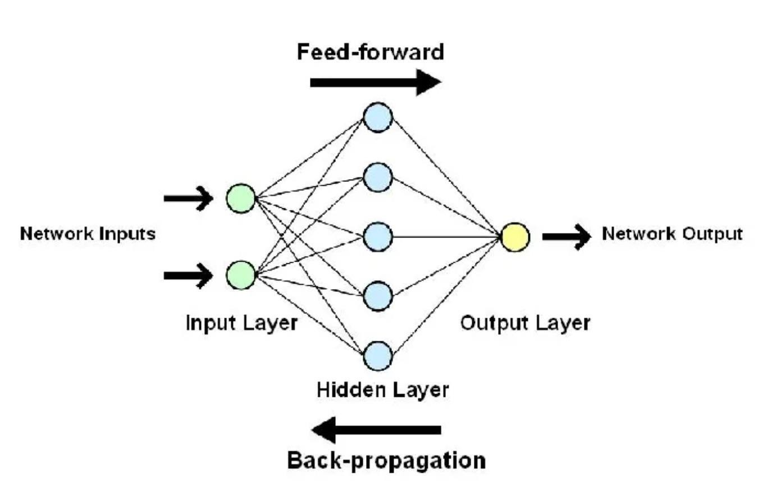
Model proposal-Artificial Neural Networks
34
A deep learning model inspired by the human brain’s structure.
Consists of three layers: input , hidden and output layers, connected by the neurons.
Feedforward phase: Input data is passed through the layers, producing a prediction.
Backward Phase: Evaluates the error and updates the weights to improve the performance.

Slide 29
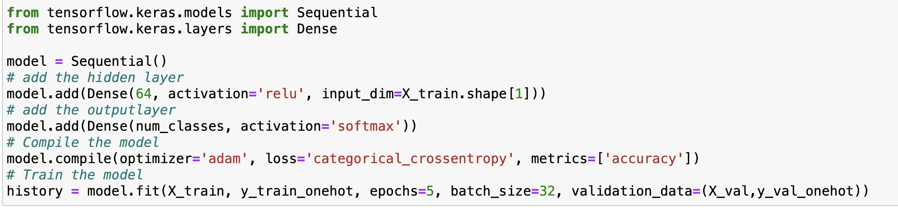
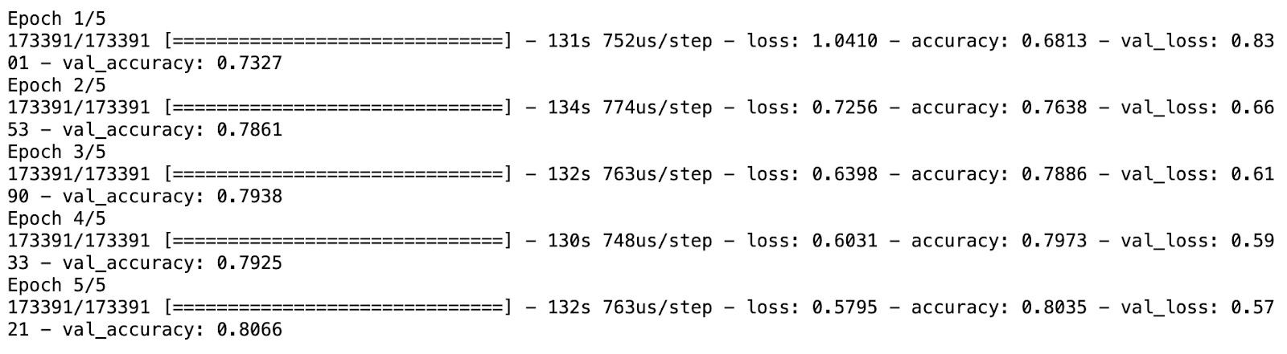
Model Support- Artificial Neural Networks
35
Baseline Model Implementation
Hyperparameters:
One hidden layer with 64 neurons
Epochs: Number of
iterations over the entire dataset
Batch_size: number of instances processed
before updating the
weights
Loss: Loss function used to evaluate the model
Baseline Model Training Report

Slide 30
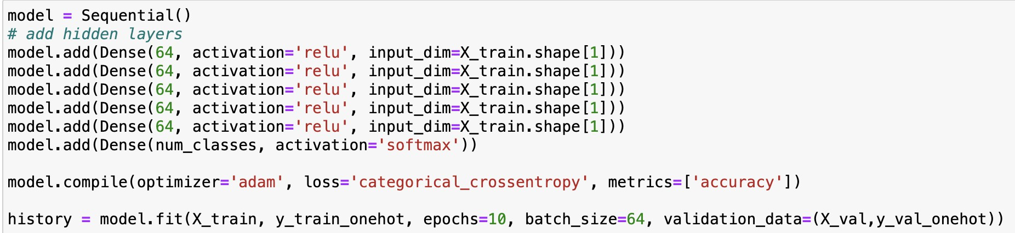
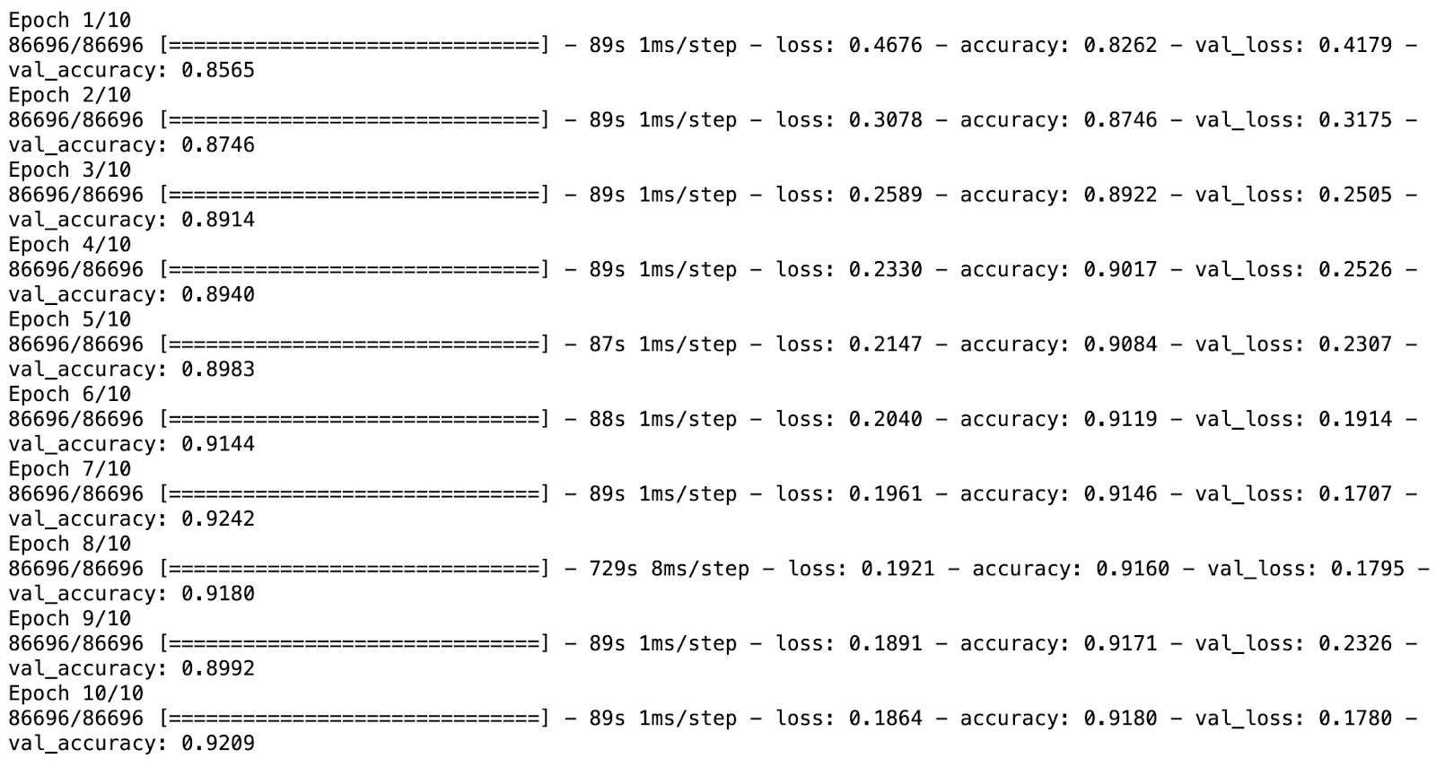
Model Building-Artificial Neural Networks
36
Hyperparameters:
Hidden Layers: 5
Nodes in hidden layers: 64
Epochs: 10
Batch_size: 64
Loss: Cross Entropy
Performance
After Hyper tuning the model, the accuracy increased from 81% to 92% and f1 score increased from 79% to 91%.
The running time decreases from 130s to 90s.

Slide 31
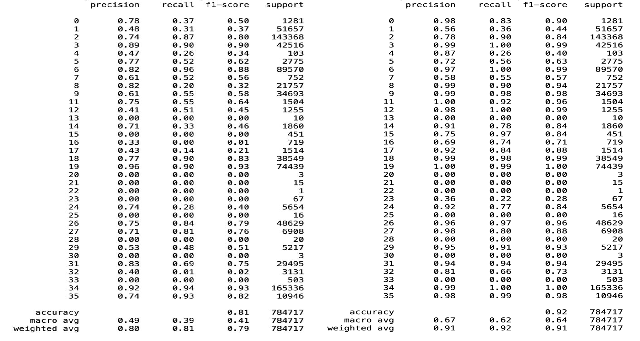
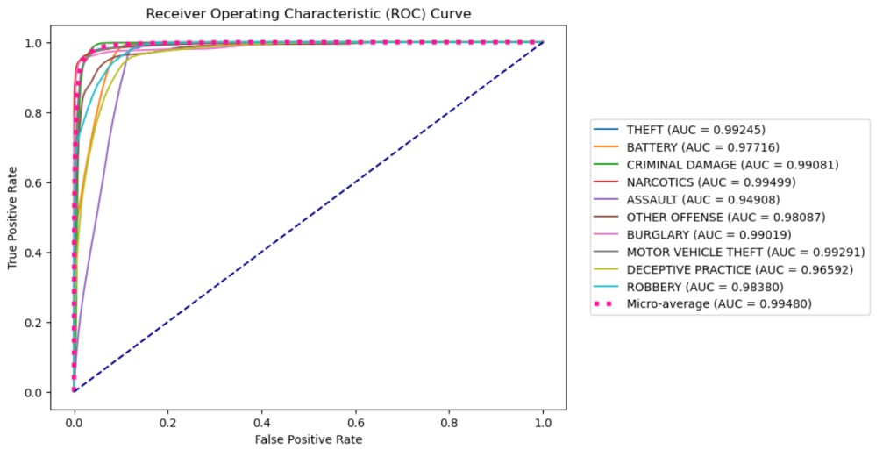
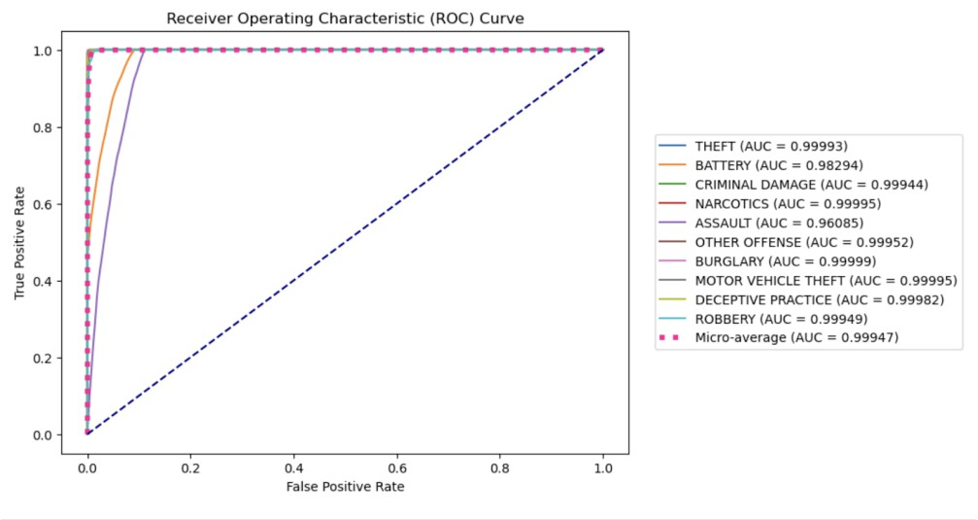
Model Evaluation- Artificial Neural Network³ ⁷s
Classification report Before Tuning After Tuning ROC Curve Before Tuning
After Tuning

Slide 32
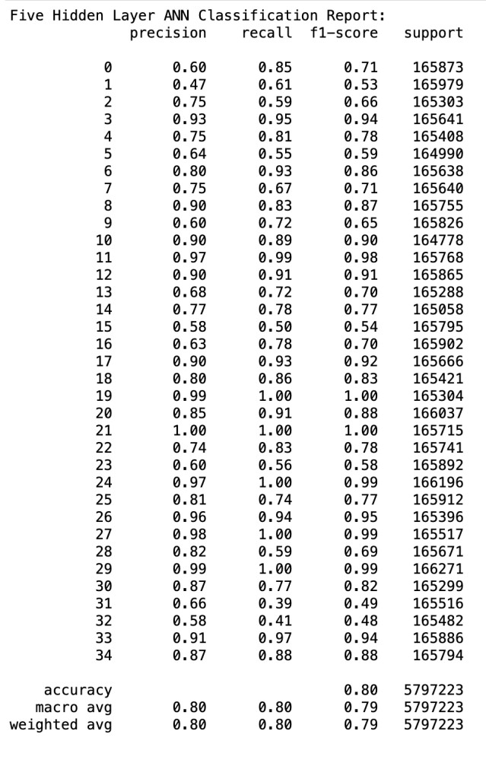
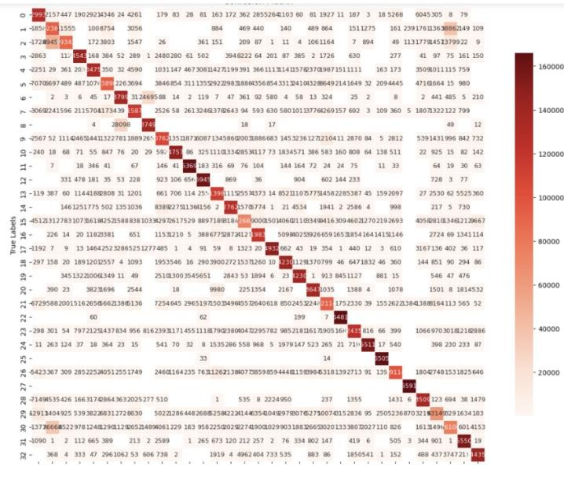
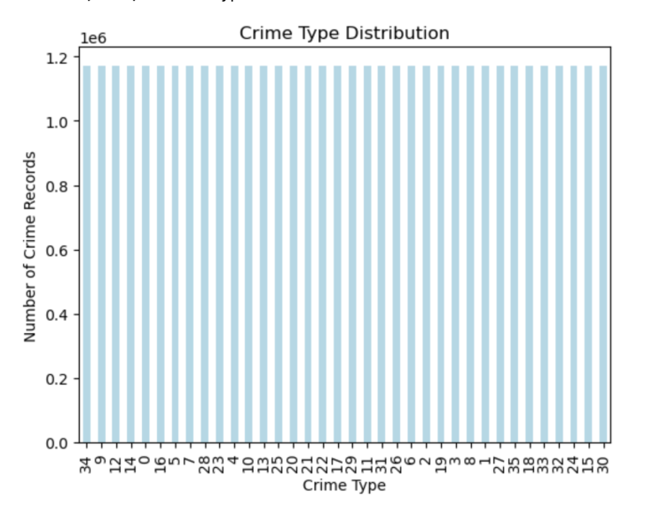
Model Evaluation- Artificial Neural Networks
Classification Report After Balancing
38
Confusion Matrix After Balancing
Crime Type Distribution
After Tuning

Slide 33
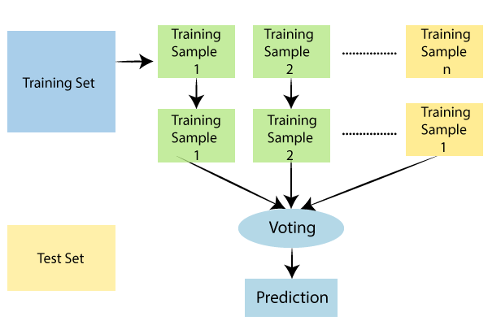
Model Proposal-Random Forest
39
Random Forest uses a combination of decision trees, enabling collaborative decision-making by multiple models.
The algorithm uses a voting system to reduce the risk of overfitting by taking into account the majority prediction from the group of trees.
Random Forest achieves high accuracy and efficiency in predictions by consolidating forecasts from multiple trees.
Studies, such as Abdulraheem M. et al.'s crime prediction and Guo et al.'s mining cost estimation, highlight the effectiveness of Random Forest in achieving accurate predictions and valuable insights.

Slide 34


Model Support- Random Forest
40
Baseline Model
n_estimators: Determines number of decision trees in each forest.
max_depth: Maximum levels in each tree.
min_samples_split: Minimum number of branches for each tree.
min_samples_leaf: Minimum number of samples for
each leaf node.
Based on the above parameters and their respective values, baseline model is built and its evaluation is done.
Based on the evaluations the model performed well but in an attempt to enhance the performance hyper parameter tuning is done using Grid search.

Slide 35



Model Building- Random Forest
41
Hypertuned Model
After Hyper tuning the model, the performance of the model
progressed and the accuracy increased from 73% to 91% and f1
score from 70% to 91%.
Running time decreased from 7mins to 2mins

Slide 36


Model Evaluation- Random Forest
42
Classification report before Tuning
Classification report after Tuning

Slide 37


Model Evaluation-Random Forest
43
ROC curve before Tuning
ROC curve after Tuning

Slide 38

Model Proposal- XGBoost
44
XGBoost is an ensemble learning method that combines multiple decision trees sequentially,
iteratively minimizing errors.
It employs gradient boosting, optimizing prediction accuracy by iteratively adding trees and correcting errors, using a gradient descent-based approach.
XGBoost achieves high performance across various
tasks while handling diverse data types efficiently.
Study from research by Cheng Sheng et al and Haizheng Yu et al reveal the effectiveness of XGBoost in prediction highlights the potential of the models in tackling complex real-world problems with nonlinear relationships and multiple influencing factors.

Slide 39


Model Support -XGBoost
45
Baseline Model
XGBoost baseline model performed with 75 trees ('n_estimators'), 6 levels deep ('max_depth'), 0.1 learning rate.
Evaluated using 'mlogloss' ('eval_metrics') and 'multi:softmax' ('objective') on imbalanced data.
Dataset split: 70% for training, 20% for validation,
and 10% for testing.
Training completed in roughly 5.86 seconds.
Model achieved 0.91 accuracy and 0.22 loss on validation, maintaining 0.90 accuracy on the test set.

Slide 40


Model Building -XGBoost
46
Baseline model achieved 0.90 accuracy, prompting hyperparameter
tuning.
Employed GridSearchCV to optimize 'n_estimators' (100, 125) and 'learning_rate' (0.01) combinations.
n_estimators with 125 and learning rate as 0.01 are selected as best parameter.
Despite increased training time, both sets of hyperparameters yielded the same 90% accuracy on test data.
Tuning n_estimators and learning_rate at 0.01 didn't enhance accuracy despite longer training duration.
Highlighted the need for exploring other hyperparameters or techniques for potential improvement.

Slide 41


Model Evaluation- XGBoost
47
Classification report before Tuning
Classification report after Tuning
Before tuning Accuracy is 91% and f1 score is 90%
After tuning Accuracy is 90% and f1 score is 89%

Slide 42


Model Evaluation-XGBoost
48
ROC curve before Tuning
ROC curve after Tuning

Slide 43

Model Proposal-Decision Tree
49
Decision trees, a supervised learning algorithm and as a non-parametric classifier, provide a straightforward yet powerful approach with interpretability and automatic feature selection advantages.
The process of prediction in Decision Trees entails moving from the initial node to a final node, where each node makes a decision based on a particular characteristic, creating a hierarchical series of decision guidelines.
Insights from research by Rokach et al. and Ahishakiye et al. validate the practicality, simplicity, and transparency of decision trees in real-life situations, as well as enhancements to the decision tree algorithm.

Slide 44

Model Support-Decision Tree
50
Baseline Model:
Hyperparameters:
Criterion: 'gini'
Splitter strategy: 'best'
Max depth: None (unlimited growth) -
Min samples split: 2
Min samples leaf: 1
Min weighted fraction leaf: 0.0
Max features: None (consider all features)
Random state: None (allows non-deterministic behavior)
Performance:
Accuracy: 92.77%
Training time: 62.69 seconds

Slide 45


Model Building-Decision Tree
51
Hyperparameter Tuned Model
GridSearchCV: Utilized GridSearchCV for hyperparameter optimization
Duration: Approximately 8 hours for an extensive grid search
Best Hyperparameters: Criterion: 'entropy’, Max depth: 15 ,Max features: None ,Min samples leaf: 4 ,Min samples split: 5

Slide 46


Model Evaluation-Decision Tree
52
Classification report before Tuning Classification report after Tuning
Accuracy: 93%, f1 score: 93%,
before tuning.
Accuracy: 94% , f1 score:94%, after tuning.
Training time: 65.13 seconds
Generalization Assessment: Validated on an independent test set
Insights into effectiveness and
reliability of the trained decision tree

Slide 47


Model Evaluation-Decision Tree
53
ROC curve before Tuning
ROC curve after Tuning

Slide 48
Model Comparison
54
Model | Advantages | Disadvantages | Perfromance
Random Forest | Ensemble method contributes to model robustness Different trees can be built simultaneously Provides high accuracy Works with both categorical and numerical variables | Less Interpretable than DT Computationally expensive on large dataset Biased toward the dominant class | After Hyper tuning the model, the performance of the model progressed and the accuracy increased from 73% to 91% and f1 score from 70% to 91%. Running time decreased from 7mins to 2mins.
Decision Tree （C4.5） | Provides human-readable prediction Adapt to both categorical and numerical attributes Can handle missing values Scalable to large datasets | Sensitive to noisy data and outliers Designed for classification, limit support for regression Easily lead to overfitting | Accuracy: 93%, f1 score: 93%, before tuning. Accuracy: 94% , f1 score:94%, after tuning. Training time: 65.13 seconds
XGBoost | High accuracy and performance on various datasets Faster than traditional algorithm using parallel processing Includes regularization terms to reduce overfitting Handling data imbalance and missing values | Hard to find the optimal set of hyperparameters Computationally expensive, especially for large datasets Require large amount of memory Sensitive to outliers and noises | Increased training time Before tuning Accuracy is 91% and f1 score is 90% After tuning Accuracy is 90% and f1 score is 89%
ANN | Achieves high accuracy by learning autonomously from data Ability to capture the complex patterns of data Can handle incomplete or noisy data Generalizes well to unseen data | Require large amount of data for training Computationally intensive for deep neural networks Model performance affected by data preprocessing Black box nature makes it hard to interpret | After Hyper tuning the model, the accuracy increased from 81% to 92% and f1 score increased from 79% to 91%. The running time decreases from 130s to 90s.

Slide 49

Our best model
55
The results show that the decision tree model is the best model for this task.
It has the highest accuracy, precision, recall, and F1 -score.
The random forest model is the second best model, followed by the XGBoost and ANN models.
We selected Decision Tree instead of Random Forest because DTs is more interpretable and easier to visualize
than Random Forest also Random Forest is computationally intensive and is taking more time for training
when compared to decision tree.
The decision tree model was also saved using the joblib library, so that it can be used to make predictions on new data in the future.

Slide 50

Summary
56
The project's goal is to use machine learning and historical crime data to proactively identify high-risk areas for criminal behavior. Traditional methods of reactive crime prevention have limitations in adapting to changing threats, so the project aims to optimize law enforcement resources and increase public safety using predictive models such as ANN, Decision Tree, XGBoost, and Random Forest. By analyzing crime patterns and demographics, the initiative seeks to foster safer communities through early intervention strategies while minimizing societal and economic impacts.

Slide 51

Future Scope
57
Integrating diverse dataset from all over the world and not limited to the city of Chicago.
Big data integration such as including public records and
sensor data.
Implementing Geographic information system (GIS) to visualize crime pattern.

Slide 52
References
58
https://www.researchgate.net/publication/340969457_Crime_Prediction_Using_K-Nearest_Neighboring_Algorithm https://www.ijcit.com/archives/volume6/issue3/Paper060308.pdf https://www.ncbi.nlm.nih.gov/pmc/articles/PMC8529125/
https://www.irjet.net/archives/V5/i9/IRJET-V5I9192.pdf
https://www.ncbi.nlm.nih.gov/pmc/articles/PMC8081790/pdf/42492_2021_Article_75.pdf
https://www.irjmets.com/uploadedfiles/paper/issue_6_june_2022/27431/final/fin_irjmets1657108227.pdf https://ieeexplore-ieee-org.libaccess.sjlibrary.org/stamp/stamp.jsp?tp=&arnumber=8821168
https://ieeexplore.ieee.org/abstract/document/8113405 https://www.mdpi.com/2079-3197/9/2/24
https://www-sciencedirect-com.libaccess.sjlibrary.org/science/article/pii/S0301420718306901?via%3Dihub https://core.ac.uk/reader/560325700
https://link.springer.com/content/pdf/10.1023/A:1010933404324.pdf
https://ieeexplore-ieee-org.libaccess.sjlibrary.org/stamp/stamp.jsp?tp=&arnumber=9985004 https://ieeexplore-ieee-org.libaccess.sjlibrary.org/stamp/stamp.jsp?tp=&arnumber=8734193 https://arxiv.org/pdf/1603.02754.pdf https://www.sciencedirect.com/science/article/abs/pii/S0927025619307712?via%3Dihub

Slide 53


Thank you

